Slide 1
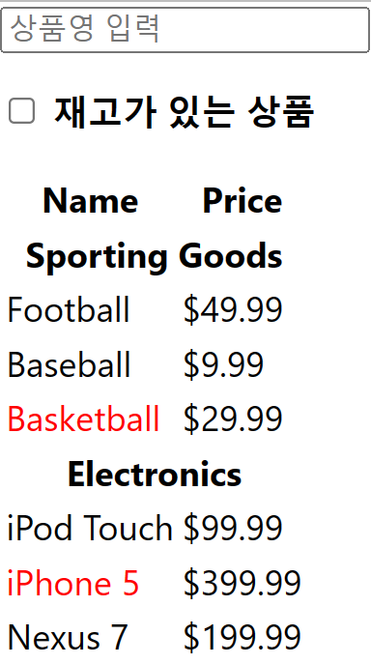
State 응용
week6-5
상품 Component
사용자 입력 Component
상품명 입력
재고 상품만 보이기
제품 출력 Component
헤더 출력 Component
각 제품 출력 Component
상품 데이터
상품 분류(Category), 가격(Price),
재고(Stock) 여부, 상품명(Name)
전체 Component
App() / Productable
User 입력 기능
SearchBar
제품 출력 기능
Product
헤더 출력 기능
CategoryRow
각 제품 출력 기능
ProductRow

Slide 2
State 응용
week6-5
import Productable from "./comp/Productable" ;
function App() {
return (
<div>
<Productable/>
</div>
);
}
export default App;
import SearchBar from './SearchBar' ;
import Product from './Product' ;
import datas from './datas' ;
const Productable = () => {
return (
<div>
<SearchBar />
<Product datas={datas} />
</div>
);
};
export default Productable;
SearchBar
Product

Slide 3
State 응용
week6-5
상품 데이터 ➔ Props
Component(함수)에 전달할 데이터(Parametner)
상품 분류(Category), 가격(Price), 재고(Stock) 여부, 상품명(Name)
const datas = [
{
category: "Sporting Goods",
price: "$49.99",
stocked: true,
name: "Football",
},
{
category: "Sporting Goods",
price: "$9.99",
stocked: true,
name: "Baseball",
},
{
category: "Sporting Goods",
price: "$29.99",
stocked: false,
name: "Basketball",
},
{
category: "Electronics",
price: "$99.99",
stocked: true,
name: "iPod Touch",
},
{
category: "Electronics",
price: "$399.99",
stocked: false,
name: "iPhone 5",
},
{ category: "Electronics",
price: "$199.99",
stocked: true,
name: "Nexus 7"
},
];
export default datas ;

Slide 4

State 응용
week6-5
State 데이터
User 검색어
체크박스
User 입력 기능
Const SearchBar = () => {
return (
<form>
<input type=“text” placeholder=“상품영 입력” />
<p>
<input type=“checkbox” /> <b>재고가 있는 상품</b>
</p>
</form>
);
};
export default SearchBar ;
SearchBar

Slide 5
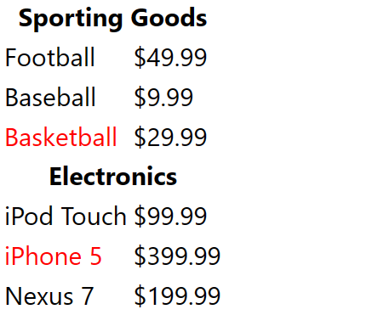
State 응용
week6-5
Rows
제품 출력 기능
<tr><th colzspan=“2”>Sporting Goods</tr>
import CategoryRow from './CategoryRow' ;
import ProductRow from './ProductRow' ;
const Product = ({datas}) => {
const rows = []; // 빈 배열
let lastCategory = null; // null 값
// 모둔 상퓸(datas)에 대해서…..
datas.forEach((data) => {
if (data.category !== lastCategory) { // category 가 다를 때
rows.push(<CategoryRow category={data.category} />)
}
// product 보냄(상품명과 가격을 출력)
rows.push(< ProductRow data ={data} />);
lastCategory = data.category;
});
return (
<table>
<tr> <th>Name</th> <th>Price</th> </tr>
{rows}
</table>
);
};
export default Product ;
<tr>< <td>Football</td> <td>$49.99</td> </tr>
<tr>< <td>Baseball</td> <td>$9.99</td> </tr>
<tr>< <td>Basketball</td> <td>$29.90</td> </tr>
<tr><th colzspan=“2”> Electronics </tr>
<tr>< <td>iPad Touchl</td> <td>$49.99</td> </tr>
<tr>< <td>iPhone 5</td> <td>$399.99</td> </tr>
<tr>< <td>Nexus 7</td> <td>$199.99</td> </tr>
빨간색 부분
검은색 부분
1행 2열

Slide 6
State 응용
week6-5
Rows
const CategoryRow = ({ category }) => {
return (
<tr>
<th colSpan="2">{category}</th>
</tr>
);
};
export default CategoryRow ;
<tr><th colzspan=“2”>Sporting Goods</tr>
<tr>< <td>Football</td> <td>$49.99</td> </tr>
<tr>< <td>Baseball</td> <td>$9.99</td> </tr>
<tr>< <td>Basketball</td> <td>$29.90</td> </tr>
<tr><th colzspan=“2”> Electronics </tr>
<tr>< <td>iPad Touchl</td> <td>$49.99</td> </tr>
<tr>< <td>iPhone 5</td> <td>$399.99</td> </tr>
const ProductRow = ({ data }) => {
const name = data.stocked ? ( // 재고가 있으면 ..
data.name // 상품명 출력
) : ( // 재고가 없으면
<span style={{ color: "red" }}>{data.name}</span>
);
return (
<tr>
<td>{name}</td>
<td>{data.price}</td>
</tr>
);
};
export default ProductRow;
<tr>< <td>Nexus 7</td> <td>$199.99</td> </tr>
빨간색

Slide 7
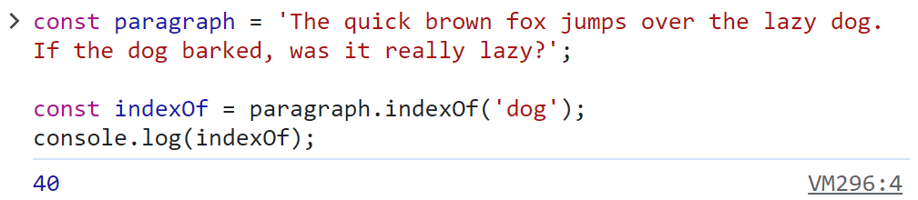
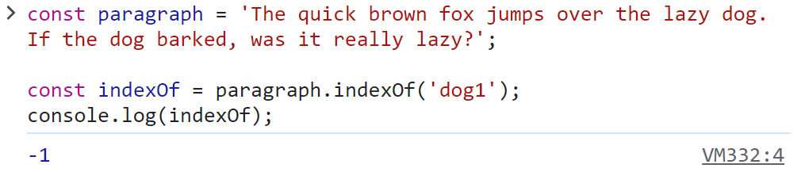
State 응용
Week6-5
const paragraph = 'The quick brown fox jumps over the lazy dog. If the dog barked, was it really lazy?’;
const indexOf = paragraph.indexOf('dog’);
console.log(indexOf);

Slide 8
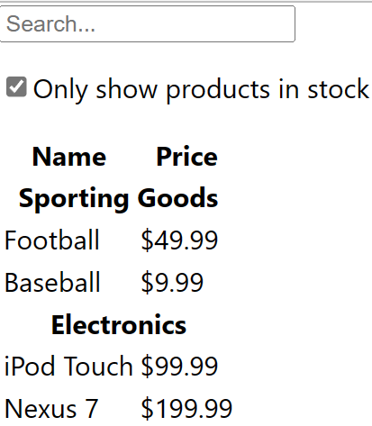
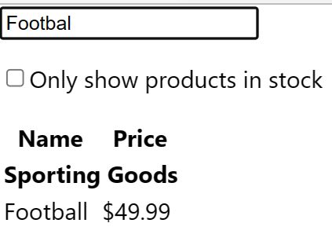
State 응용
Week6-5
datas 배열 데이터를 props로 전달을 해서 render(정적 UI )
동적 UI 상호작용
User가 입력한 검색어와 체크박스 값
재고가 있는 상품 출력
상품 검색

Slide 9
State 응용
Week6-5
return (
<div>
<SearchBar
filterText={filterText}
inStockOnly={inStockOnly}
value={filterText}
changeFilterText={changeFilterText}
changeInStockOnly={changeInStockOnly}
/>
<Product
datas={datas}
filterText={filterText}
inStockOnly={inStockOnly}
/>
</div>
);
};
export default Productable;
State 적용
상위 Component에서 state를 선언
하위 컴포넌트들이 상태를 공유함
Text 변경 과 체크박스 클릭 Event 정의
자식 컴포넌트에 State, Event 전달(Props)
State, Event
3
3
datas, State
Productable
import { useState } from 'react';
import SearchBar from './SearchBar' ;
import Product from './Product' ;
import datas from './datas' ;
const Productable = () => {
const [filterText, setFilterText] = useState("");
const [inStockOnly, setInStockOnly] = useState(false);
const changeFilterText = (e) => {
setFilterText(e.target.value);
};
const changeInStockOnly = (e) => {
setInStockOnly(e.target.checked);
};
1
2
filterText
inStockOnly

Slide 10
State 응용
Week6-5
Search
const SearchBar = (props) => {
const {filterText, inStockOnly, changeFilterText, changeInStockOnly} = props ;
return (
<form>
<input
type="text"
placeholder="Search..."
value={filterText}
onChange={changeFilterText}
/>
<p>
<input
type="checkbox"
checked={inStockOnly}
onChange={changeInStockOnly}
/>
Only show products in stock
</p>
</form>
);
};
export default SearchBar ;
State
State 변경
State
State 변경

Slide 11
Product
State 응용
import CategoryRow from './CategoryRow' ;
import ProductRow from './ProductRow' ;
const Product = ({ datas, filterText, inStockOnly }) => {
const rows = [];
let lastCategory = null;
datas.forEach((data) => {
if (data.name.indexOf(filterText) === -1) return;
if (inStockOnly && !data.stocked) return;
if (data.category !== lastCategory) {
rows.push( <CategoryRow category={data.category} key={data.category} />
);
}
rows.push(<ProductRow data={data} key={data.name} />);
lastCategory = data.category;
});
return (
<table>
<tr><th>Name</th> <th>Price</th> </tr>
{rows}
</table>
);
};
export default Product ;
Week6-5
상품명과 동일한 상품이 없으면 반복 다시 시작
Checkbox에 Check되어 있거나 stocked 가 false

Slide 12
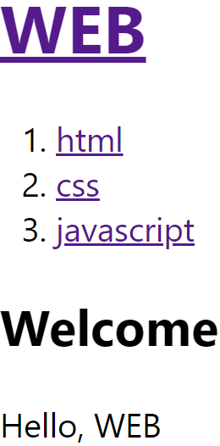
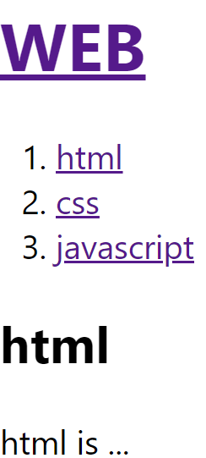
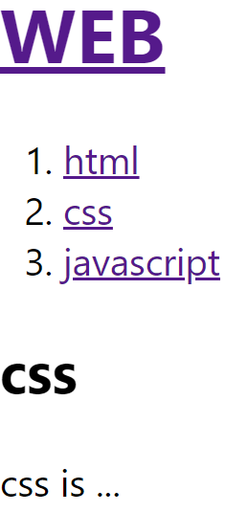
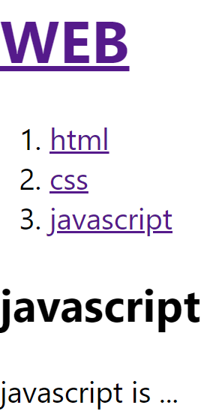
State 응용
week6-6
Nav Component를 클릭 할 경우
Article Component에 다음과 같이 Render
Header
Nav
Article

Slide 13
import { useState } from "react";
import Header from "./comp/Header";
import Nav from "./comp/Nav";
import Article from "./comp/Article";
import datas from "./comp/datas";
function App() {
const [mode, setMode] = useState("WELCOME");
const [id, setId] = useState("");
let content = null;
if (mode === "WELCOME") {
// WELCOME 일 경우 실행
content = <Article title="Welcome" body="Hello, WEB"></Article>;
} else if (mode === "READ") {
let title, body = null;
for (let i = 0; i < datas.length; i++) { // READ 일 경우 실행
console.log(datas[i].id, id);
if (datas[i].id === number(id)) {
title = datas[i].title;
body = datas[i].body;
}
}
content = <Article title={title} body={body}></Article>;
}
return (
<div>
<Header
title="WEB"
onChangeMode={() => {
setMode("WELCOME");
}}
></Header>
<Nav datas={datas}
onChangeMode={(_id) => {
setMode("READ"); // mode 변경
setId(_id);
}}
></Nav>
{content}
</div>
);
}
export default App;
1
2
3
클릭한 id와 data에서 동일한 id

Slide 14
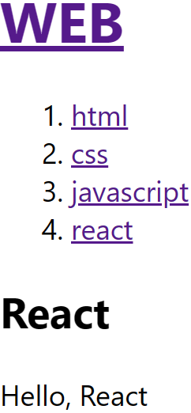
State 응용
week6-6
Event 예제
Props
const datas = [
{ id: 1, title: "html", body: "html is ..." },
{ id: 2, title: "css", body: "css is ..." },
{ id: 3, title: "javascript", body: "javascript is ..." },
{ id: 4, title: "react", body: "react is ..." },
];
export default datas ;
<li> 로 출력

Slide 15
State 응용
week6-6
function Nav(props) {
const lis = [];
for (let i = 0; i < props.datas.length; i++) {
let t = props.datas[i];
lis.push(
<li key={t.id}>
<a id={t.id} href={"/read/" + t.id}
onClick={(event) => {
event.preventDefault();
props.onChangeMode(event.target.id);
}}
>
{t.title}
</a>
</li>
);
}
return (
<nav>
<ol>{lis}</ol>
</nav>
);
}
export default Nav ;
function Header(props) {
return (
<header>
<h1>
<a href="/“ onClick={(event) => {
event.preventDefault();
props.onChangeMode();
}} >
{props.title}
</a>
</h1>
</header>
);
}
export default Header ;
2
문자열을 숫자로
function Article(props) {
return (
<article>
<h2>{props.title}</h2>
{props.body}
</article>
);
}
export default Article ;

Slide 16
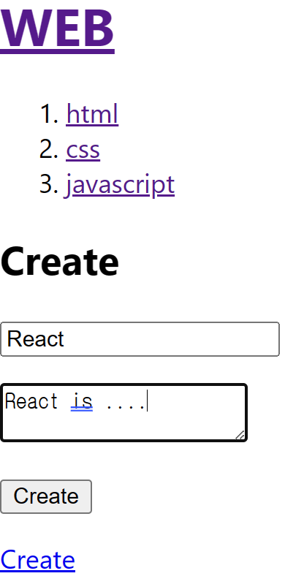
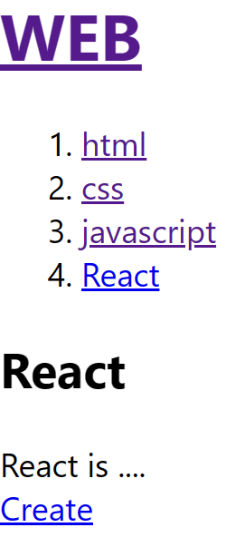
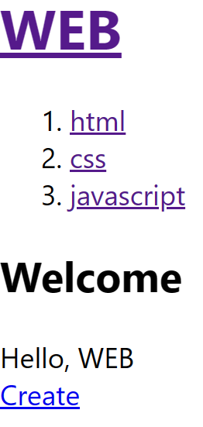
State 응용
week6-6
Create
App.js
Header
Conponent
Nav
Conponent
Article
Conponent
Create
Conponent
Welcome
Read
Create

Slide 17
State 응용
week6-6
let content = null;
if (mode === "WELCOME") {
content = <Article title="Welcome" body="Hello, WEB"></Article>;
} else if (mode === "READ") {
let title, body = null;
for (let i = 0; i < topics.length; i++) {
if (topics[i].id === Number(id)) {
title = topics[i].title;
body = topics[i].body;
}
}
content = <Article title={title} body={body}></Article>;
} else if (mode === "CREATE") {
content = (
<Create
onCreate={(_title, _body) => {
const newTopic = { id: nextId, title: _title, body: _body };
const newTopics = [...topics]; // 기존 topics
newTopics.push(newTopic); // 기존 추가 topics
setTopics(newTopics);
setMode("READ"); // READ모드
setNextId(nextId + 1); // Id 증가
}}
></Create>
);
}
import { useState } from "react";
import Header from "./comp/Header";
import Nav from "./comp/Nav";
import Article from "./comp/Article";
import datas from "./comp/datas";
import Create from "./comp/Create";
function App() {
const [mode, setMode] = useState("WELCOME");
const [id, setId] = useState(null);
const [nextId, setNextId] = useState(4);
const [topics, setTopics] = useState(datas);
1
데이터
2
CREATE를 클릭하면 실행
4
7
추가 데이터
다음 id
초기 tiopis는 datas
입력한 id, title, topics를 추가

Slide 18
Event
State 응용
week6-6
First Rendering
return (
<div>
<Header title="WEB“ onChangeMode={() => {
setMode("WELCOME");
}} >
</Header>
<Nav topics={topics}
onChangeMode={(_id) => {
setMode("READ");
setId(_id);
}} >
</Nav>
{content}
<a href="/create“ onClick={(event) => {
event.preventDefault();
setMode("CREATE");
}} >
Create
</a>
</div>
);
}
Header
Conponent
Nav
Conponent
{content}
Create
추가코드
3
3

Slide 19
Event
State 응용
week6-6
function Nav({topics, onChangeMode}) {
const lis = [];
for (let i = 0; i < topics.length; i++) {
let t = topics[i];
lis.push(
<li key={t.id}>
<a id={t.id} href={"/read/" + t.id}
onClick={(event) => {
event.preventDefault();
onChangeMode(event.target.id);
}}
>
{t.title}
</a>
</li>
);
}
return (
<nav>
<ol>{lis}</ol>
</nav>
);
}
export default Nav ;
변화 있음
function Header(props) {
return (
<header>
<h1>
<a
href="/"
onClick={(event) => {
event.preventDefault();
props.onChangeMode();
}}
>
{props.title}
</a>
</h1>
</header>
);
}
export default Header;
변화 없음
function Article(props) {
return (
<article>
<h2>{props.title}</h2>
{props.body}
</article>
);
}

Slide 20
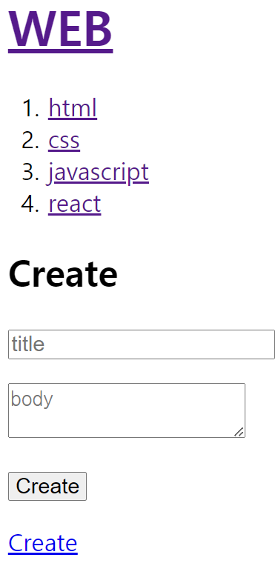
Event
State 응용
week6-6
5
추가 컴포넌트
function Create(props) {
// const { onCreate } = props;
return (
<article>
<h2>Create</h2>
<form
onSubmit={(event) => {
event.preventDefault();
const title = event.target.title.value;
const body = event.target.body.value;
props.onCreate(title, body);
}}
>
<p> <input type="text" name="title" placeholder="title" /> </p>
<p> <textarea name="body" placeholder="body"></textarea> </p>
<p> <input type="submit" value="Create"></input> </p>
</form>
</article>
);
}
export default Create;
6

Slide 21
고급웹프로그래밍
7 주차 수업자료
네비게이션
React 웹 만들기
https://velopert.com/3275

Slide 22
React Router
웹 페이지 이동
HTML
<a href="#" />
React 환경에서도 사용 가능
새 페이지가 열람
React 기능은 없어짐
필요한 부분만 Render하는 React 장점이 없어짐
React
<Link to={＂#“} />
Npm install react-router-dom@5
"react-router-dom": "^5.3.4",
Npm install react-router-dom@6
"react-router-dom": "^6.17.0",
Version에 따라 사용법이 차이가 있음

Slide 23
React Router
Week7-1
라우팅(Routing)
BrowserRouter
최상 단 component 감싸주기
Link : a 태그와 동일 기능
<Link to="경로">링크명</Link>
import { BrowserRouter, Link } from "react-router-dom";
function App() {
return (
<BrowserRouter>
<p>라우팅(Routing)</p>
<a href="http://naver.com"> 네이버 </a> <br />
<Link to={"http://naver.com"}> 네이버 </Link>
</BrowserRouter>
);
}
export default App;

Slide 24
React Router
Week7-1
Route
Path 속성 : 경로
Element속성 : component
"react-router-dom": "^5.3.4",
function Home() {
return (
<div>
<h2>홈페이지입니다.</h2>{" "}
</div>
);
}
// -----------------------------------------
function About() {
return (
<div>
<h2>About페이지 입니다.</h2>;{" "}
</div>
);
}
export default App;
import { BrowserRouter, Route, Link } from "react-router-dom";
const App = () => {
return (
<BrowserRouter>
<Link to="/">홈</Link>
<Link to="/about">소개</Link> <hr />
<Route exact path="/" component={Home} />
<Route path="/about" component={About} />
</BrowserRouter>
);
};

Slide 25
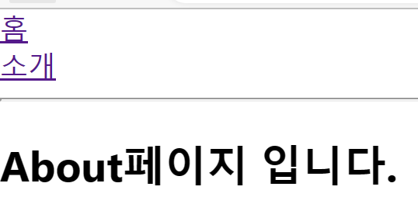
React Router
Week7-1
"react-router-dom": "^6.17.0",
import { BrowserRouter, Routes, Route, Link } from "react-router-dom";
const App = () => {
return (
<BrowserRouter>
<Link to="/home">홈</Link>
<Link to="/about">소개</Link> <hr />
<Routes>
<Route path="/" Component={Home} />
<Route path="/about" Component={About} />
</Routes>
</BrowserRouter>
);
};
function Home() {
return ( <div> <h2>홈페이지입니다.</h2> </div> );
}
function About() {
return ( <div> <h2>About페이지 입니다.</h2> </div> );
}
export default App;
Routes
일치하는 Route를 Render
Route
Path = “경로”
Component = {Component 명}
이 부분에 Component Rendenr

Slide 26
React Router
React 라우팅(Routing)
import {BrowserRouter, Routes, Route, Link } from 'react-router-dom’;
BrowserRouter
최상 단 component 감싸주기
Routes
일치하는 Route를 Render
Route
Path 속성 : 경로
Element속성 : component
Link : a 태그와 동일 기능
<Link to="경로">링크명</Link>

Slide 27
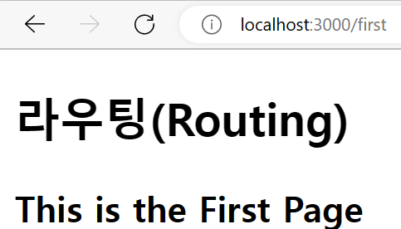
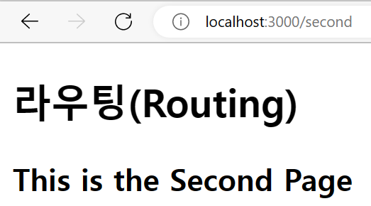
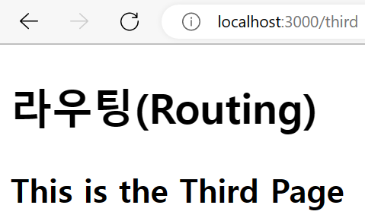
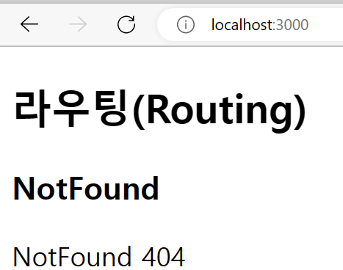
React Router
Week7-2
React 라우팅(Routing) 예
일치되는 라우터가 없을 경우
import { BrowserRouter, Route, Routes } from "react-router-dom";
import FirstPage from "./comp/FirstPage";
import SecondPage from "./comp/SecondPage";
import ThirdPage from "./comp/ThirdPage";
import NotFound from "./comp/NotFound";
function App() {
return (
<BrowserRouter>
<h2>라우팅(Routing)</h2>
<Routes>
<Route path="/first" element={<FirstPage />} />
<Route path="/second" element={<SecondPage />} />
<Route path="/third" element={<ThirdPage />} />
<Route path="*" element={<NotFound />}></Route>
</Routes>
</BrowserRouter>
);
}
export default App;
일치되는 러우터가 없을 경우

Slide 28
React Router
Week7-2
const FirstPage = () => {
return (
<div> <h3>This is the First Page</h3> </div>
);
};
const SecondPage = () => {
return (
<div> <h3>This is the Second Page</h3></div>
);
};
const ThirdPage = () => {
return (
<div> <h3>This is the Third Page</h3> </div>
);
};
const NotFound = () => {
return (
<div>
<h1>NotFound</h1>
<p>NotFound 404</p>
</div>
);
};

Slide 29
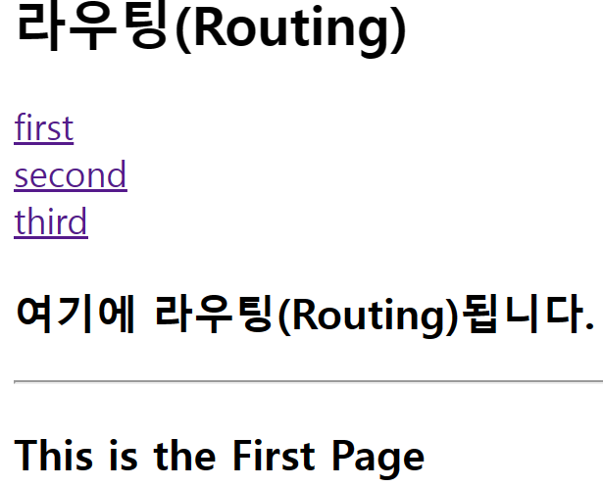
React Router
Week7-2
import { BrowserRouter as Router, Route, Routes, Link } from "react-router-dom";
import FirstPage from "./comp/FirstPage";
import SecondPage from "./comp/SecondPage";
import ThirdPage from "./comp/ThirdPage";
import NotFound from "./comp/NotFound";
function App() {
return (
<Router>
<h2>라우팅(Routing)</h2>
<Link to="/first">first</Link> <br />
<Link to="/second">second</Link> <br />
<Link to="/third">third</Link> <br />
<h2>여기에 라우팅(Routing)됩니다.</h2> <hr />
<Routes>
<Route path="/first" Component={FirstPage} />
<Route path="/second" Component={SecondPage} />
<Route path="/third" Component={ThirdPage} />
<Route path="*" Component={NotFound}></Route>
</Routes>
</Router>
);
}
export default App;
React 라우팅(Routing) 예
BrowserRouter as Router
추가 코드

Slide 30
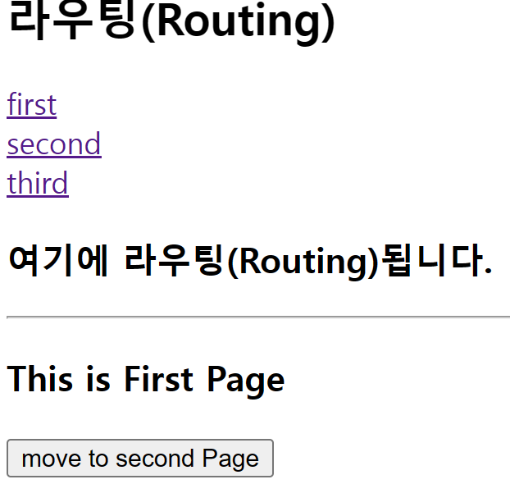
React Router
Week7-3
useNavigate() Hook
버튼 Click Event를 통해 Routing
App 컴포넌트는 prj_1과 동일
import { useNavigate } from "react-router-dom";
const FirstPage = () => {
const navigate = useNavigate(); // 네비게이트 Hook
// second 페이지로 이동
const onclock = () => navigate("/second");
return (
<div>
<h3>This is First Page</h3>
<button onClick={onclock}>move to second Page
</button>
</div>
);
};
export default FirstPage;

Slide 31
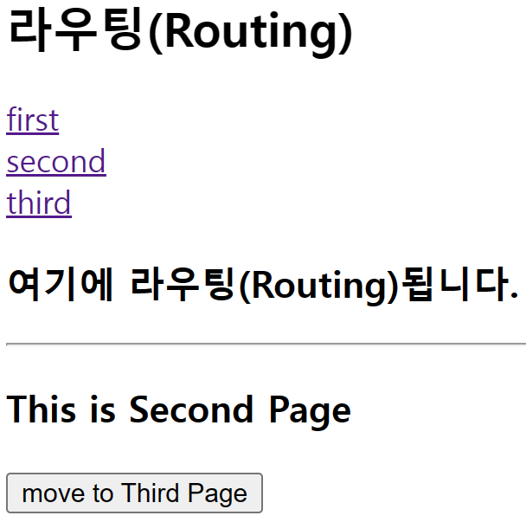
React Router
Week7-3
import { useNavigate } from "react-router-dom";
const SecondPage = () => {
const navigate = useNavigate();
// third 페이지로 이동
const onclock = () => navigate("/third");
return (
<div>
<h3>This is Second Page</h3>
<button onClick={onclock}>move to Third Page
</button>
</div>
);
};
export default SecondPage;

Slide 32
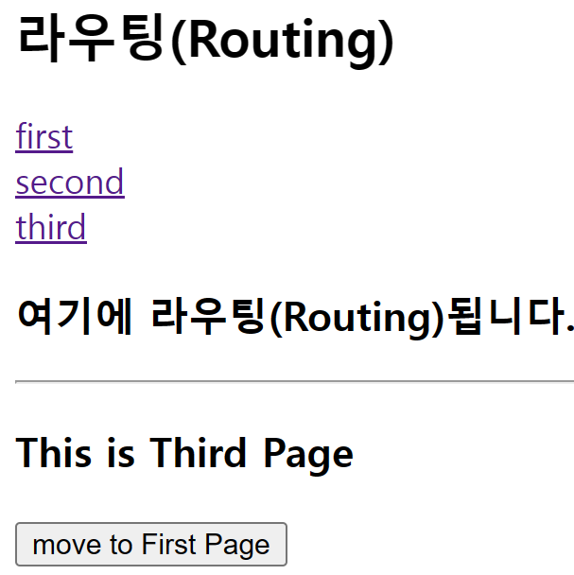
React Router
Week7-3
import { useNavigate } from "react-router-dom";
const ThirdPage = () => {
const navigate = useNavigate();
// first 페이지로 이동
const onclock = () => navigate("/first");
return (
<div>
<h3>This is Third Page</h3>
<button onClick={onclock}>move to First Page</button>
</div>
);
};
export default ThirdPage;

Slide 33
React Router
Week7-4
import { BrowserRouter as Router, Routes, Route, Link } from "react-router-dom";
import Home from "./comp/Home";
import Recommend from "./comp/Recommend";
import Search from "./comp/Search";
import MyPage from "./comp/MyPage";
const App = () => {
return (
<div className="App">
<Router>
<div className="header">
<Link to="/" className="item"> Home </Link><br />
<Link to="/myPage" className="item"> MyPage </Link><br />
<Link to="/recommend" className="item"> Recommand </Link><br />
<Link to="/search" className="item"> Search </Link><br />
</div>
<Routes>
<Route exact path="/" Component={Home} />
<Route path="/mypage" Component={MyPage} />
<Route path="/recommend" Component={Recommend} />
<Route path="/search" Component={Search} />
</Routes>
</Router>
</div>
);
};
export default App;
React 라우팅(Routing) 예
function Home() {
return <h1>Home Page</h1>;
}
function Recommend() {
return <h1>Recommend Page</h1>;
}
function Search() {
return <h1>Search Page</h1>;
}
function MyPage() {
return <h1>My Page</h1>;
}
Exact : 자신의 path에 위치해야만 render.

Slide 34
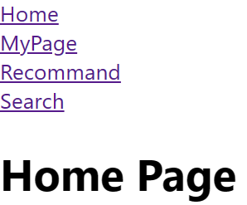
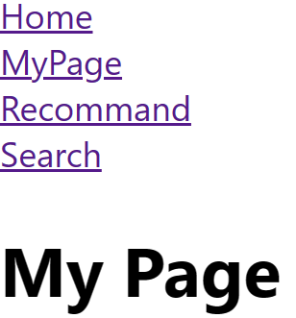

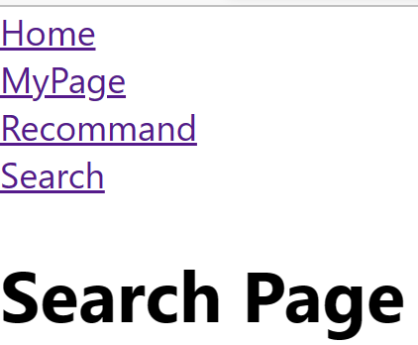
React Router
Week7-4

Slide 35
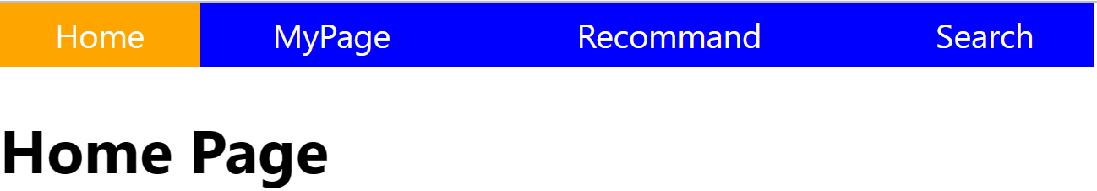
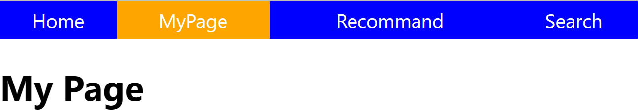
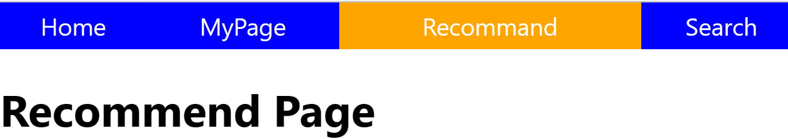
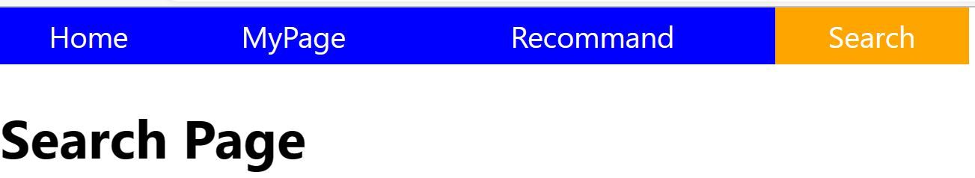
React Router
Week7-4
Menu CSS 적용

Slide 36
import { BrowserRouter as Router, Routes, Route, Link } from "react-router-dom";
import Home from "./comp/Home";
import Recommend from "./comp/Recommend";
import Search from "./comp/Search";
import MyPage from "./comp/MyPage";
import "./App.css";
const App = () => {
return (
<div className="App">
<Router>
<div className="header">
<Link to="/" className="item"> Home </Link>
<Link to="/myPage" className="item"> MyPage </Link>
<Link to="/recommend" className="item"> Recommand </Link>
<Link to="/search" className="item"> Search </Link>
</div>
<Routes>
<Route exact path="/" Component={Home} />
<Route path="/recommend" Component={Recommend} />
<Route path="/search" Component={Search} />
<Route path="/mypage" Component={MyPage} />
</Routes>
</Router>
</div>
);
};
export default App;
App.css
.header {
background : blue ;
display: table ;
width : 70%
}
.item {
text-align : center ;
padding-top : 5px ;
padding-bottom : 5px;
display : table-cell ;
color : white ;
text-decoration : none ;
font-size : 1.1rem ;
}
.item:hover {
background : orange ;
}
.item:active {
background : white;
color : blue;
}
Component 로 작성

Slide 37
React Router
Week7-4
Link 부분을 component 로 작성
Header Compont 생성
import { Link } from "react-router-dom";
const Header = () => {
return (
<div className="header">
<Link to="/" className="item"> Home </Link>
<Link to="/MyPage" className="item"> MyPage </Link>
<Link to="/Recommand" className="item"> Recommand </Link>
<Link to="/Search" className="item"> Search </Link>
</div>
);
};
export default Header;

Slide 38
React Router
Week7-4
파라메터 전송 1
import { BrowserRouter as Router, Routes, Route } from "react-router-dom";
import Header from "./comp/Header";
import Home from "./comp/Home";
import Recommend from "./comp/Recommend";
import Search from "./comp/Search";
import MyPage from "./comp/MyPage";
import "./App.css";
const App = () => {
return (
<div className="App">
<Router>
<Header />
<Routes>
<Route exact path="/" Component={Home} />
<Route path="/mypage/:name" Component={MyPage} />
<Route path="/recommend" Component={Recommend} />
<Route path="/search" Component={Search} />
</Routes>
</Router>
</div>
);
};
export default App;
파라메터 명 : name

Slide 39
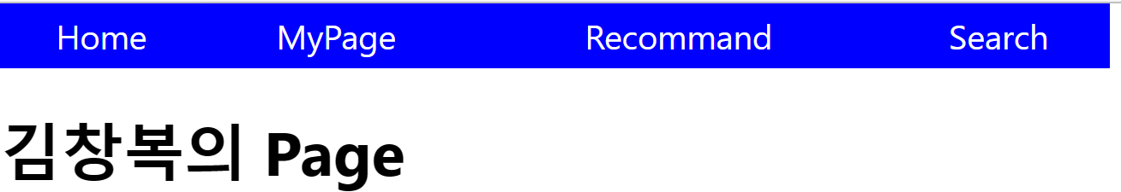
React Router
Week7-4
파라메터 전송 1
useParams Hook
"react-router-dom": "^6.17.0",
import { useParams } from "react-router-dom";
const MyPage = () => {
const { name } = useParams();
return (
<div>
<h1>{name}의 Page</h1>;
</div>
);
};
export default MyPage;
Import React from “react”;
Import { Link } from “react-router-dom”;
const Header = () => {
return (
<div className=“header”>
<Link to=“/” className=“item”> Home </Link>
<Link to=“/mypage/김창복” className=“item”> MyPage
</Link>
<Link to=“/recommend” className=“item”> Recommand
</Link>
<Link to="/search" className="item"> Search </Link>
</div>
);
};
export default Header;
파라메터 값 : 김창복

Slide 40

React Router
Week7-5
파라메터 전송 2
"react-router-dom": "^6.17.0",
import { BrowserRouter as Router, Routes, Route } from "react-router-dom";
import Home from "./comp/Home";
import Recommend from "./comp/Recommend";
import Search from "./comp/Search";
import MyPage from "./comp/MyPage";
import Posts from "./comp/Posts";
import Header from "./comp/Header";
import "./comp/Header.css";
const App = () => {
return (
<div className="App">
<Router>
<Header />
<Routes>
<Route exact path="/" Component={Home} />
<Route path="/mypage/:name" Component={MyPage} />
<Route path="/recommend" Component={Recommend} />
<Route path="/search" Component={Search} />
<Route path="/posts/:study" Component={Posts} />
</Routes>
</Router>
</div>
);
};
export default App;
Header.js
<Link to="/posts/REACT" className="item">
Posts
</Link>
import { useParams } from "react-router-dom";
const Posts = () => {
// const params = useParams();
const { study } = useParams();
return (
<div>
{/* <h1>{params.study}의 Post Page</h1> */}
<h1>{study}의 Post Page</h1>
</div>
);
};
export default Posts;

Slide 41
React Router
Week7-5
"react-router-dom": "^5.3.4",
파라메터 전송 3
import { BrowserRouter as Router, Route } from "react-router-dom";
import Home from "./comp/Home";
import Recommend from "./comp/Recommend";
import Search from "./comp/Search";
import MyPage from "./comp/MyPage";
import Posts from "./comp/Posts";
import Header from "./comp/Header";
import "./App.css";
const App = () => {
return (
<div className="App">
<Router>
<Header />
<Route exact path="/" component={Home} />
<Route path="/mypage/:name" component={MyPage} />
<Route path="/recommend" component={Recommend} />
<Route path="/search" component={Search} />
<Route path="/posts/:study" component={Posts} />
</Router>
</div>
);
};
export default App;

Slide 42
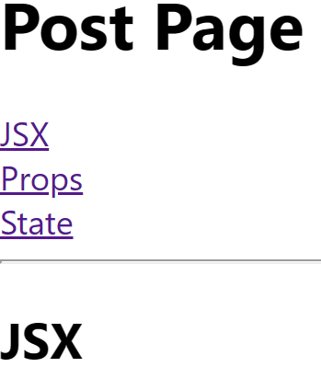
React Router
Week7-5
"react-router-dom": "^5.3.4",
파라메터 전송 3
import { Route, Link } from "react-router-dom";
const Posts = () => {
return (
<div>
<h1>Post Page</h1>
<Link to="/posts/JSX"> JSX </Link>
<br />
<Link to="/posts/Props"> Props </Link>
<br />
<Link to="/posts/State"> State </Link>
<br />
<hr />
<Route path="/posts/:titles" component={Post} />
</div>
);
};
const Post = ({ match }) => {
return <h2>{match.params.titles}</h2>;
};
export default Posts;
이부분 만 Router 됨
이부붑만 Render

Slide 43
React Router
Week7-6
라우팅 예제
Post Component를 다음과 같이 수정합니다.
import { Route, Link } from "react-router-dom";
import JSX from "./JSX";
import Props from "./Props";
import State from "./State";
const Posts = () => {
return (
<div>
<h1>Post Page</h1>
<Link to="/posts/JSX"> JSX </Link> <br />
<Link to="/posts/Props"> Props </Link> <br />
<Link to="/posts/State"> State </Link> <br /> <hr />
<Route path="/posts/JSX" component={JSX} />
<Route path="/posts/Props" component={Props} />
<Route path="/posts/State" component={State} />
</div>
);
};
export default Posts;

Slide 44
React Router
Week7-6
const JSX = () => {
return (
<div>
<h2>JSX</h2>
<ul>
<li>JavaScript + HTML/XML</li>
<li>A syntax extension to JavaScript</li>
<li>React는 JSX 코드를 React Element로 변환 </li>
<li>JSX 사용 장점</li>
<ul>
<li>코드가 간결</li>
<li>가독성이 향상</li>
<li>해킹 방어</li>
</ul>
</ul>
<div>
<p>JSX 예시</p>
HTML 내에 JavaScript 프로그램이 삽입됨
<img src ="/image/jsx.gif" width="700px" height = "400px" alt="jsx 예시"></img>
</div>
</div>
);
};
export default JSX;

Slide 45
React Router
Week7-6
import React from 'react';
const Props = () => {
return (
<div>
<h2>Props</h2>
<ul>
<li>React Props(Property) : Component(Tag)가 가지는 속성을 설정</li>
<li>부모 Component에서 자식 Component에 전달하는 Data</li>
<li>Props는 Element 에서 수정 불가능</li>
<li>같은 props에 대해서 같은 Element 생성</li>
<li>문자열을 전달 : 큰따옴표(" ") </li>
<li>문자열 외 : 중괄호({ })</li>
</ul>
<div>
<p>Props 예시</p>
동일한 Component에 Props를 달리해서 다른 Element를 생산
<img src ="/image/props.gif" width="600px" height = "400px" alt="jsx 예시"></img>
</div>
</div>
);
};
export default Props;

Slide 46
React Router
Week7-6
import React from 'react';
const State = () => {
return (
<div>
<h2>State</h2>
<ul>
<li>React의 핵심 Hook</li>
<li>UI + Data </li>
<li>Ui(User Interface) 와 Data(State)를 하나로 묶음 </li>
<li>React는 Data 중심으로 Render</li>
<li>State가 변경되면 화면이 자동으로 Render</li>
</ul>
<div>
<p>State 예시</p>
<img src ="/image/state.gif" width="700px" height = "400px" alt="jsx 예시"></img>
</div>
</div>
);
};
export default State;

Slide 47
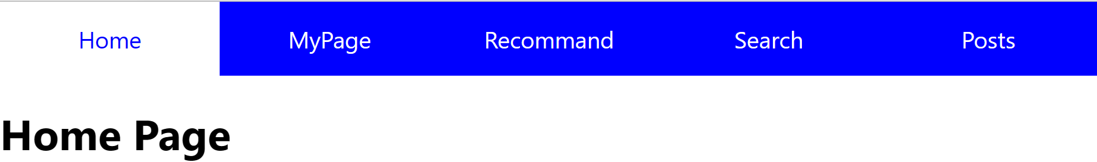
React Router
Week7-7
클릭한 탭 만 활성화하기
.item.active {
background : white;
color : blue;
}
import React from "react";
import { NavLink } from "react-router-dom";
const Header = () => {
return (
<div className="header">
<NavLink exact to="/" className="item“>
Home
</NavLink>
<NavLink to="/myPage/김창복" className="item" >
MyPage
</NavLink>
<NavLink to="/recommend" className="item" >
Recommand
</NavLink>
<NavLink to="/search" className="item"> Search </NavLink>
<NavLink to="/posts" className="item"> Posts </NavLink>
</div>
);
};
export default Header;

Slide 48
React Router
Week7-8
<NavLink to="/login" className="item">
Login
</NavLink>
<NavLink to="/mypage1" className="item">
MyPage1
</NavLink>
Redirect component
Mypage 클릭했을 경우
로그인 안되었다면 로그인 페이지로 자동이동
const App = () => {
return (
<div className="App">
<Router>
<Header />
<Route exact path="/" component={Home} />
<Route path="/mypage/:username" component={MyPage} />
<Route path="/recommend" component={Recommend} />
<Route path="/search" component={Search} />
<Route path="/posts" component={Posts} />
<Route path="/login" component={Login} />
<Route path="/mypage1" component={MyPage1} />
</Router>
</div>
);
};
import { Redirect } from "react-router-dom";
const MyPage1 = () => {
const logged = false;
return (
<div>
{!logged && <Redirect to="/login" />}
<h1>MyPage1</h1>
</div>
);
};
const Login = () => {
return (
<div>
<h1>로그인</h1>
</div>
);
};

Slide 49
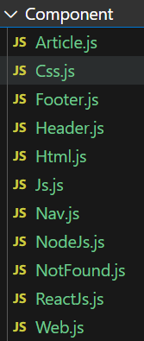
React Router
CSS-Router
import { BrowserRouter } from "react-router-dom";
import { Route, Routes } from "react-router-dom";
import React from "react";
import Header from "./Component/Header";
import Nav from "./Component/Nav";
import Web from "./Component/Web";
import Html from "./Component/Html";
import Css from "./Component/Css";
import Js from "./Component/Js";
import ReactJs from "./Component/ReactJs";
import NodeJs from "./Component/NodeJs";
import NotFound from "./Component/NotFound";
import Article from "./Component/Article";
import Footer from "./Component/Footer";
import "./App.css";

Slide 50
React Router
CSS-Router
function App() {
return (
<BrowserRouter>
<div>
<Header />
<div className="container">
<Nav />
<Routes>
<Route path="/" element={<Web />} />
<Route path="/html" element={<Html />} />
<Route path="/css" element={<Css />} />
<Route path="/js" element={<Js />} />
<Route path="/reactjs" element={<ReactJs />} />
<Route path="/nodejs" element={<NodeJs />} />
<Route path="*" element={<NotFound />} />
</Routes>
<Article />
</div>
<Footer />
</div>
</BrowserRouter>
);
}
export default App;

Slide 51
React Router
CSS-Router
import { Link } from "react-router-dom";
function Nav() {
return (
<nav>
<Link to={"/html"}>HTML</Link>
<Link to={"/css"}>CSS</Link>
<Link to={"/js"}>JavaScript</Link>
<Link to={"/reactjs"}>ReactJs</Link>
<Link to={"/nodejs"}>NodeJs</Link>
</nav>
);
}

Slide 52
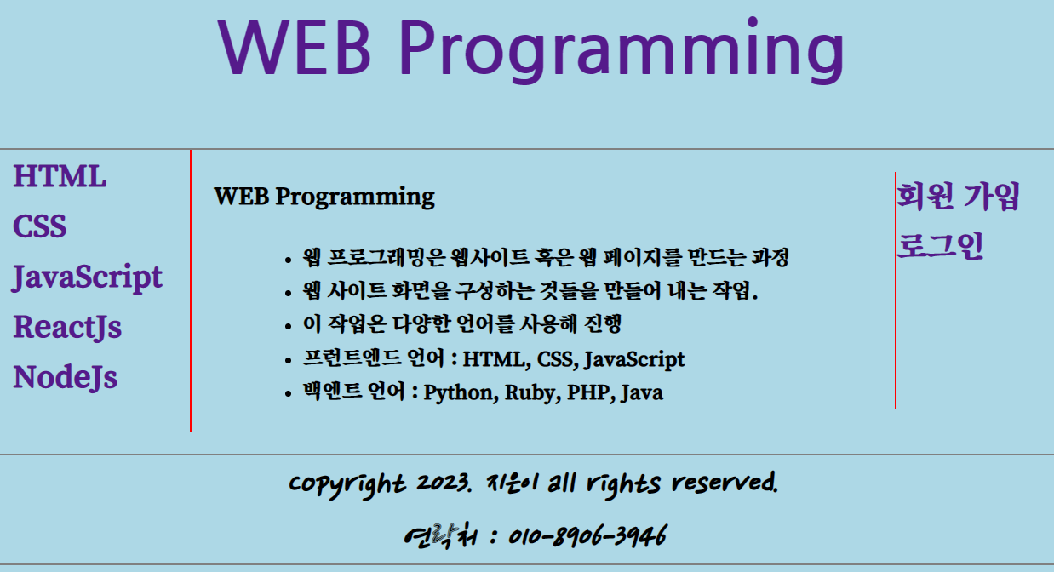
React Router
CSS-Router

Slide 53
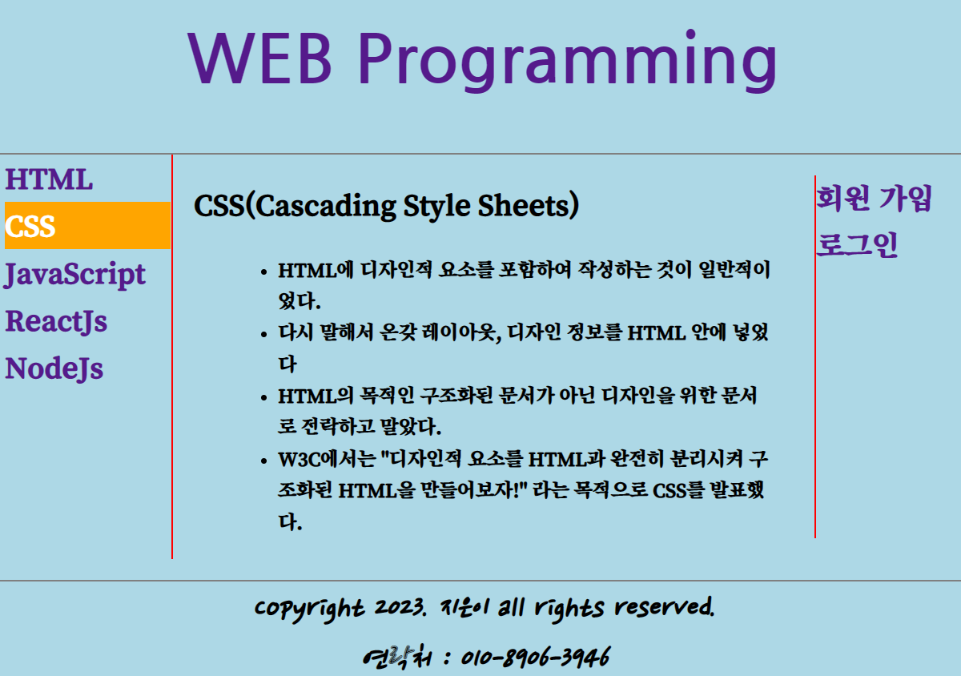
React Router
CSS-Router

